Slide 1


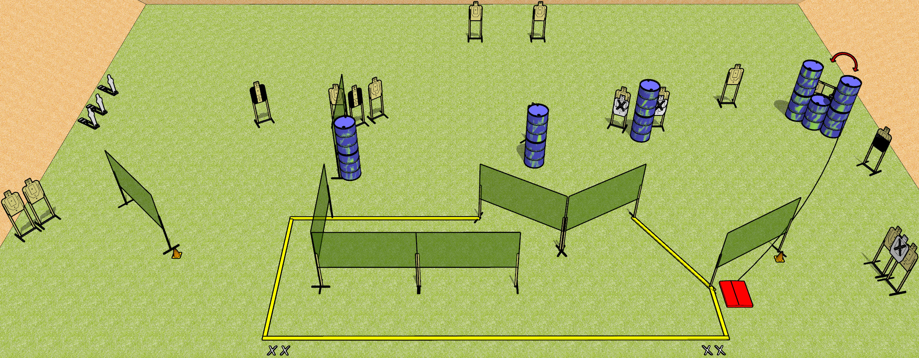
 | Dothan Gun Club – USPSA Match Clusterfuck Course Designer : Drew Coleman
START POSITION : Standing with both feet on either set of X’s, wrists below belt
GUN READY CONDITION : Pistol loaded and holstered. PCC loaded, held with both hands, shouldered, safety on, pointed at either orange cone. |  | SCORING: Comstock, 35 rounds TARGETS: 16 paper, 3 Steel SCORED HITS: Best 2 on paper, steel until down START-STOP: Audible, last shot RULES:
STAGE PROCEDURE: Engage targets as they become available from within the fault lines.

Slide 2
Clusterfuck
Written Stage Briefing
Clusterfuck is a 35 round, 175 point, Comstock field course. There are sixteen USPSA targets and three mini poppers. The best two hits on paper will score, and steel must fall to score.
The stomp box activates the swinger. Please check the activator prior to walkthrough and set it the same way every time. The swinger is not disappearing.
Handgun start position is both feet on either set of X’s, wrists below belt. Handgun is loaded and holstered.
PCC start position is both feet on either set of X’s, muzzle pointed at orange cone. Loaded carbine is held with both hands, safety on, shouldered.
On start signal, engage targets as they become available from within the shooting area.

